Slide 1
Digital Dashboard Capstone
Team Members: Sean Koppenhafer, Jaime Rodriguez,
Chad Thueson, Noah Erickson, Rishal Dass
Notes:
Slide Purpose: Introduce ourselves

Slide 2

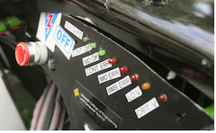
Project Overview
Electric systems add complexity and traditional LED dash would not suffice
Drivers must be aware of system faults and warnings
A Digital Dashboard must be created to accommodate additional electrical systems
Formula SAE Electric Car
Traditional LED Dashboard
Notes:
Slide Purpose: What did we have to do

Slide 3
Requirements
Size
Price
Reproducible
User-Friendly
LCD Screen < 4”
Custom PCB
LCD Screen < 4”
Arduino Based
Arduino Based
Arduino Based
Custom PCB
LCD Screen < 4”
LCD Screen < 4”
Notes:
Slide Purpose: Show requirements linked to decisions

Slide 4
Consideration – Microprocessor
 | Cost | Custom Board | CAN Controller | CAN Library | SPI, I²C, UART, etc
ATMEGA328 | $3 | Yes | No | No | Yes
AT90CAN | $8 | Yes | Yes | Yes | Yes
Arduino Uno | $25 | No | No | No | Yes
Arduino Due | $50 | No | Yes | No | Yes
ATSAM3X | $12 | Yes | No | Yes | yes
The ATSAM3X was chosen with the following consideration:
Custom PCB
External MCP-2551 CAN Transceivers
ATSAM3X
4DSystems LCD
Digital Dashboard
CAN Communication
Notes:
Slide Purpose: Why we chose the ATSAM3X

Slide 5
Consideration – Screen
 | Cost | Size | Color | Visibility | Software
EarthLCD | $219 | 3.5” | Yes | Yes | Yes
New Haven | $60 | 4.9” | No | Yes | No
Sun LCD | ??? | 3.5” | Yes | Yes | No
4D Systems | $89 | 3.5” | Yes | No | Yes
The 4D Systems Screen was chosen with the following consideration:
Overdriven Display Voltage
Polarizing Shield
ATSAM3X
4DSystems LCD
Digital Dashboard
CAN Communication
Notes:
Slide Purpose: Why we decided on the screen

Slide 6
Consideration – Comm. Protocol
 | Complexity | Available
I²C | Simple | Yes
SPI | Simple | Yes
CAN | Complex | Yes
Wi-Fi |  | No
ATSAM3X
4DSystems LCD
Digital Dashboard
CAN Communication
Notes:
Slide Purpose: why we decided on CAN
CAN was already implemented

Slide 7
System Overview
CAN Buses
GEVCU
Microcontroller
LCD Screen
Power Supply
Notes:
Slide Purpose: Show how the system connects

Slide 8
Printed Circuit Board
Features
Small Size
2-Layer Designed for easy reflow
Multiple Power Supply Inputs
Flush Mating Header
Inputs
5V or 12V Power
Outputs
LCD Mating Header
Programming Port
CAN Bus 1 High and Low
CAN Bus 2 High and Low
Functionally an Arduino Due
LCD Mating
Header
CAN Inputs
Programming Circuit
12V Supply
Notes:
Slide Purpose: Show off our awesome PCB

Slide 9
Software
Format is .ino
Can be uploaded via programming port and Arduino IDE
Notes:
Slide Purpose: Show off our awesome software

Slide 10
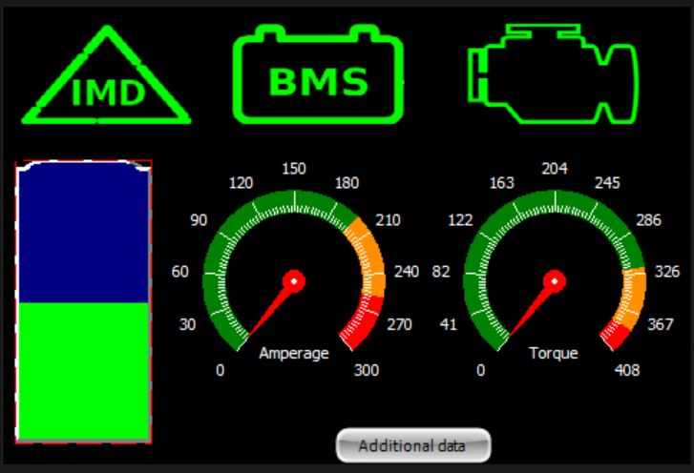
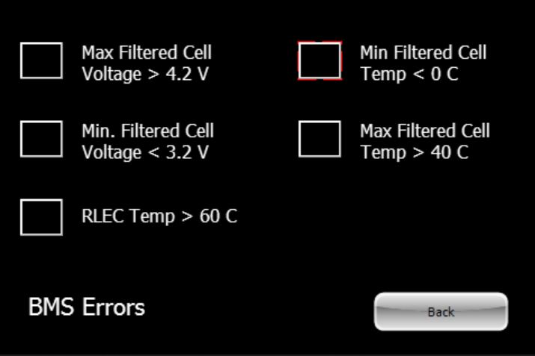
GUI
4D Systems ViSi-Genie
High contrast for quick interpretation
Touch enabled subscreen buttons
Main Screen
BMS Subscreen
Notes:
Slide Purpose: Show GUI decisions

Slide 11
Testing
Notes:
Slide Purpose: Talk about demo unit?

Slide 12
Programming
Mainboard
Disconnect the 4D Systems LCD
Connect the external programmer to the programming port
Upload desired code via Arduino IDE
4D Systems LCD
Disconnect the 4D Systems LCD
Connect the external 4D Systems Programmer
Upload desired code via 4D Systems ViSi-Genie
Upload desired GUI to 4D Systems microSD card
Notes:
Slide Purpose: Show how easy it is to reprogram

Slide 13
Reproducibility
Notes:
Slide Purpose: Show how to reproduce a unit

Slide 14

Documentation
Reproduction Instructions
Development Team Biographies
Development Team Progress Meetings
Development Roadblocks and Milestones
Budget and Schedule
Test Plans
Notes:
Slide Purpose: Show what documentation we have

Slide 15
Future Revisions
Revision 2.0
Software
Enclosure
Mainboard
Polling Based
Smaller
Programming Circuit
Power Supply
LCD Header
Notes:
Slide Purpose: Show what we could improve

Slide 16
Conclusion
Notes:
Slide Purpose: wrap this up

